Slide 1

Object-oriented analysis and design. Application version diagram and elements of its graphical notation. Features of conceptual design

Slide 2

(OOAD)
Object-Oriented Analysis and Design (OOAD) is a methodology for analyzing, designing, and implementing software systems based on the principles of object-oriented programming. In OOAD, the system is viewed as a collection of interacting objects, each encapsulating data and behavior. Here's an overview of OOAD, including the application version diagram, its graphical notation elements, and the features of conceptual design:

Slide 3

Analysis Phase
- Purpose: During this phase, the system requirements are gathered, analyzed, and specified. The focus is on understanding the problem domain and identifying the objects, their attributes, behaviors, and relationships. - Techniques: Use case modeling, class modeling, sequence diagrams, activity diagrams, and state diagrams are commonly used techniques in OOAD for capturing and representing system requirements.

Slide 4

Design Phase
- Purpose: In this phase, the system architecture is designed based on the requirements identified during the analysis phase. The focus is on defining the structure and behavior of the system, including the classes, interfaces, relationships, and interactions between objects. - Techniques: Class diagrams, object diagrams, sequence diagrams, collaboration diagrams, and package diagrams are used to design the system architecture and specify the details of object interactions.

Slide 5
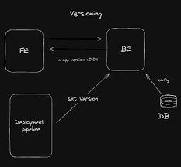
Application Version Diagram
Application Version Diagram: The Application Version Diagram is a graphical notation used in OOAD to represent the different versions or releases of a software application, along with their dependencies and relationships. It helps in managing the evolution and maintenance of the software over time. Elements of Graphical Notation: The graphical notation used in the Application Version Diagram typically includes the following elements:

Slide 6
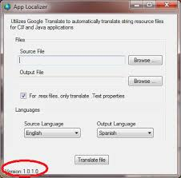
Application Version
- Represents a specific version or release of the software application. - Usually depicted as a labeled box or node, indicating the version number or release name. In software development, an "Application Version" refers to a specific iteration or release of a software application. It's often represented as a labeled box or node in diagrams or documentation, indicating the version number or release name. This helps users and developers to identify and differentiate between different iterations of the software, as each version may introduce new features, bug fixes, or other changes.

Slide 7

Dependencies
- Represents the dependencies between different versions of the application. - Arrows or lines connecting the version nodes indicate the dependencies, such as prerequisites or compatibility requirements.3. Relationships: - Represents the relationships between different versions, such as inheritance or reuse of functionality. - Arrows or lines connecting the version nodes indicate the relationships between them, such as "extends," "implements," or "uses."

Slide 8
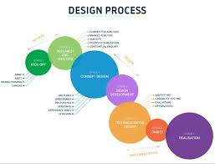
Features of Conceptual Design:
Abstraction: - Conceptual design focuses on abstracting the essential elements and concepts of the system, without getting into implementation details. - It helps in understanding the problem domain and defining the core concepts of the system.2. Modeling: - Conceptual design involves creating models that represent the problem domain and its entities, attributes, behaviors, and relationships. - Models such as class diagrams, use case diagrams, and entity-relationship diagrams are used to capture and represent the conceptual design.

Slide 9

Analysis
- Conceptual design involves analyzing the problem domain to identify the requirements, constraints, and objectives of the system. - It helps in defining the scope and boundaries of the system and understanding the user's needs and expectations.4. Iteration: - Conceptual design is an iterative process, where the initial concepts and ideas are refined and evolved based on feedback and further analysis. - It allows for continuous improvement and refinement of the design to ensure that it meets the requirements and goals of the system.

Slide 10

summary
Object-Oriented Analysis and Design (OOAD) is a systematic approach to software development that focuses on modeling the system as a collection of interacting objects. The Application Version Diagram, along with its graphical notation elements, helps in managing the evolution and dependencies of software applications. Conceptual design, characterized by abstraction, modeling, analysis, and iteration, lays the foundation for designing effective and scalable software systems.

